Slide 1
Managing Continuity and achieving Resiliency
Navigating The pandemic
NEW YORK
March 30, 2020

Slide 2




OVERVIEW
COVID-19 has disrupted business continuity around the globe. Organizations must quickly adapt to the fluctuating environment through proactive action to ensure resiliency in this global crisis.
PANDEMIC PREPAREDNESS: EVOLVING TRADITIONAL CONTINUITY PLANNING
Sound continuity planning is more essential than ever to minimize disruptions to the financial stability of the global economy, maintain the trust and confidence of customers, and defend strategic viability.
Traditional business continuity plans have revolved around localized technology or operational failure events and national disasters,
but did not focus on the most severe scenarios that can have significant impacts and implications on a global scale.
 | Traditional | Pandemic
Duration | Generally shorter and finite | Indeterminate; can span months and multiple waves
Scope | Disruption is localized / contained | Disruption is systemic and in flux
Infrastructure | Relies on backup facilities and public services | Must account for widespread remote work and possible public service disruption
Workforce | Temporary shortages or repositioning | Significant (>40%) shortages and ongoing health concerns¹
Incorporating the impact of a pandemic into scenario analysis is uniquely complex given the number of unknown variables such as scale, duration, and public response.
Severe global disruption events require an unprecedented level of coordination with local, state and national authorities, in addition to global regulatory bodies.

Slide 3








Immediate areas of focus
Financial institutions can take immediate measures in key areas to ensure ongoing resiliency as the crisis evolves.
Capco has identified the following critical components of resiliency where prompt action will help mitigate business disruption and enable swift recovery.
Critical Functions
Workforce Strategy & Optimization
Cybersecurity
Infrastructure / Technology
Communications
Facilitate the identification and prioritization of business-critical functions.
Conduct an impact assessment to define and map critical functions / services to provide the transparency needed to mitigate further disruptions.
Develop a clear hierarchy of essential personnel, considering critical functions, decision-making authority, and covered personnel.
Establish specific policies for physical and financial employee protection.
Review infrastructure in place to enable remote work (e.g. VPN connections, security tokens, laptops) and assess capacity, bandwidth, and authentication mechanisms.
Add additional protective measures to mitigate weaknesses in cybersecurity and data protection caused by remote work.
Identify which operations and/or activities can be rerouted to alternative offices, offshore delivery centers or third parties if needed.
Assess relaxing Offshore Delivery Center (ODC) regulations without compromising critical data loss prevention requirements.
Refine engagement model to deepen customer relationships and provide proactive assurances.
Establish robust ongoing internal communications
Coordinate with third parties to develop contingency strategies.
Additional Considerations
Culture & Awareness
Governance
Third Party
Develop a robust and prompt communication channel, including dialogue between leadership and the workforce, to address concerns.
Create a Continuity board that will make decisions on crisis management, including leaders from critical business units that understand the daily operations of the on-ground workforce.
Develop contingency strategies for third-party providers supporting critical functions, particular for areas with heightened concentration or cyber risk.

Slide 4






Critical Functions
How capco can help
The identification of critical functions is essential to how an organization prioritizes resiliency measures to ensure continuity in a crisis scenario.
Coordinate with key stakeholders across critical functions to define specific impact scenarios.
1
2
3
Scenario Analysis
Business Impact Assessment
Response Playbook
Identify scenarios against macro-economic shifts from impacted industries, clients and counterparties to understand the ways your critical functions may shift and reprioritize through different time periods.
Assess each identified scenario and determine how your critical business operations will change depending on the levers of variability encompassed by each scenario.
Define action plans in response to each identified scenario to mitigate disruptions and ensure continuity as the economic environment evolves.
Run scenarios through a Business Impact Assessment to gauge pandemic-related disruption.
Impact
Draft playbooks defining and prioritizing response action plans to mitigate scenario impact on critical functions.
Understanding the ways that specific scenarios will impact critical functions empowers organizations to create strategic, prioritized, and immediately actionable resilience plans.
4

Slide 5



Workforce Strategy & optimization
How capco can help
Organizations must remain agile in their pandemic workforce approach to transition human capital to support critical functions.
Define interim workforce configurations and accompanying operating models to support critical functions across geographies.
Resource Demand Evaluation
    Prioritize continuity of critical functions in defining interim workforce configurations based on scenarios to accommodate resource constraints.
Critical Resource Activation
    Perform necessary cross-training to prepare interim resources for adequate performance.
  Alternative Work Arrangements
    Institute flexible work arrangements that foster a healthy environment while ensuring technology is functioning and secure.
Organizational Strategy & Design
    Determine size, shape, layers, span of control, and geographical distribution for the new organizational design.
Workforce Reintegration
    Reintroduce workforce in increments and invest in the training and skills required to optimize contribution and career growth.
Operational Optimization
    Implement digital collaboration practices and tools in support of distributed team productivity.
Continuity
Administration
Employee Welfare
    Develop trackers to measure employee health, and emotional, financial and employment wellbeing with managerial support and communication.
  Employee Capacity
    Plan for capacity upgrades to minimize the risk of resource exhaustion.
Employee Productivity
    Identify a performance-potential matrix outlining employees’ performance – focusing on output.
Craft playbooks for rapid workforce reorganization (personnel ramp up/down) and transition to steady state.
Develop Workforce Model / Dashboard leveraging data and Machine Learning to monitor employee welfare, capacity, and productivity.
Rapid
Workforce Pivot
The
“New Normal”
5

Slide 6










cybersecurity
How capco can help
Focused attention on the early mitigation of cyber risks is critical as financial institutions transition to more vulnerable operational setups.
Technology Risks
Review your current operational set-up to identify, prioritize, and address critical security risks.
Additional risk exposure due to increased attack surface of remote work arrangements and higher susceptibility to threat vectors such as ransomware, cyber fraud and phishing.
Reduced security posture from misconfigurations / short-cuts used to rapidly set up remote work environments (e.g., access policy violations) and widespread vulnerabilities for end points (e.g. laptops).
Breakdown of cybersecurity tools & processes not designed to sustain the continued stress (e.g., VPNs not sized for current needs, lack of strong authentication) from operational changes.
Systemic Risks
Develop the plan to enhance your short-term cybersecurity posture while adapting to operational changes.
Heightened third-party risks due to challenges in accessing third-party applications / infrastructure from outside of corporate networks, and no contractual agreement to support loss of access.
Reduced ability to respond to cyber incidents if institutions implement widespread staff cuts to adapt to economic challenges perpetuated by a global health crisis.
Limited effectiveness of security policies / standards (e.g., remote access, authentication) that have not been designed or tested for pandemic-driven shifts in the operational environment.
People Risks
Design the target-state cyber resilience framework to ensure continuity in future severe adverse scenarios for the “New Normal”.
Social engineering scams that exploit people’s fear of the coronavirus and enable such cyber crimes as Business Email Compromise (BEC), PII theft, ransomware, and account takeovers.
Limited staff awareness of threats in the new operational environment, resulting in susceptibility to aggressive attacks from adversaries exploiting fears.
Non-feasibility of manual tasks as workarounds for digital channels during public health emergencies due to personnel movement restrictions.
6

Slide 7


Infrastructure & technology
How capco can help
IT functions must respond quickly to changing technology needs and develop strategic plans to ensure resilience.
Impact
Increased outages or delayed system availability due to human disruption (local and global).
Recommendation
  Revise remote working procedures to allow for resource flexibility and continuity.
  Leveraged Technology – Cloud Computing
  Double down on DDoS (distributed denial-of-service) threat detection and mitigation.
  Enable on-demand computing power, storage expansion, and outsourcing maintenance needs.
Conduct a Digital Readiness Assessment to understand any gaps in the current infrastructure.
System
Availability
Impact
Delayed upgrades and maintenance and uncertainty around short-term organizational goals.
Recommendation
  Revise & upgrade schedule to prioritize critical updates.
  Leveraged Technology – AI Chatbot
  Implement AI chatbots as first interaction agent to reduce burden on workforce, as well as customer waiting times.
Expedited Cloud Adoption Roadmap to facilitate transition away from physical dependencies.
Network
Stability
Impact
Infrastructure disruption from overloaded platforms / servers and resource scalability.
Recommendation
  Reassess Recovery Time Objectives (RTO) and Recovery Point Objectives (RPO) to allow for resource rationalization.
  Leveraged Technology – Remote Connectivity
  Plan to reallocate/augment server by leveraging additional resources like network bandwidth, digital channels as well as offloading from low priority capabilities.
AI & Chatbot Development to upgrade customer support through increased demand.
Platform Capacity
7

Slide 8



communications
How Capco can help
How capco can help
Frequent and transparent communication goes a long way in maintaining the trust of key stakeholders.
Refresh communication plans to ensure strategic alignment on crisis management.
Mitigation
Proactive Outreach
Provide decisive guidance on best practices in a pandemic to keep your workforce safe and productive.
Boost employee confidence and morale by facilitating frequent dialogue between leadership and the workforce.
Employees
Strategize customer support and update online capabilities to boost relationships.
Evaluate your current policies and practices, anticipate changes and define alternatives to enable swift adaptation.
Define customer communications touchpoints to gather real-time feedback and engage in meaningful dialogue; focus on the future.
Customers
Consult your legal team and business leads to get ahead of potential liabilities and breaches.
Be transparent about the operational and financial impacts of the global crisis, and request extensions where necessary.
Regulators
Evaluate and implement new communication channels to enhance remote capabilities.
Assess alternatives for essential service providers before a problem manifests to minimize potential interruptions and get ahead of competitors.
Coordinate closely with critical third parties to ensure timely knowledge of service disruptions.
Suppliers
8

Slide 9












Capco’s continuity and resiliency offerings
Our unique acceleration services provide end-to-end support from planning to operational implementation and sustainability.
Critical functions
Workforce Strategy & Optimization
CYBERSECURITY
Infrastructure / Technology
COMMUNICATIONS
Interim Workforce Operating Model
Critical Risk Prioritization & Remediation
Digital Readiness Assessment
Refreshed Pandemic Communication Strategy
Scenario Analysis
Enhanced
Short Term Cybersecurity Posture
Enhanced Digital Customer Support Capabilities
Business Impact Assessment
Workforce Transition Playbooks
Cloud Adoption Roadmap
Prioritized Scenario Response Playbooks
Workforce Model / Dashboard
Target State Cyber Resiliency Framework
Vendor Technology Sourcing & Implementation
AI & Chatbot Development

Slide 10
CAPCO’S CREDENTIALS: BCP, RESILIENCE, FINANCE, RISK & COMPLIANCE
AREAS OF EXPERTISE | HIGHLIGHTED EXPERIENCE | TOP 10 US BANK | GLOBAL TIER 1 INVESTMENT BANK | FOREIGN BANKING ORGANIZATION | GOVERNMENT SPONSORED ENTITY
BUSINESS CONTINUITY | Served as strategic advisor and execution partner to support broad range of BCP efforts, including: BCM Organizational Design; Program Implementation; BCP & Disaster Recovery Planning & Testing; Disaster Recovery Controls Analysis; BCP Tools Setup and Implementation; and Business Impact Analysis Setup. |  |  |  | 
OPERATIONAL RESILIENCY | End to end Operational Resiliency assessment across People, Processes, and Technology: Current State Observations & Findings; Capability & Maturity Scorecards; Target State Recommendations & Roadmaps; and Resiliency Plan Development. |  |  |  | 
CRITICAL RESOURCE/SERVICE MAPPING | Developed an inventory of critical resources (people, processes, technology, and facilities) needed to support business functions across legal entities and jurisdictions: Current State Data Assessment & Gap Analysis; Scope and Scale Identification; Data Refinement/Collection/Creation; Service Taxonomy Design; and Review & Challenge. |  | 
CYBERSECURITY | Comprehensive Cybersecurity support, including: Cyber Risk Assessment; Cyber Capability Analysis; Identification and Correction of Deficiencies in Cybersecurity Controls, Policies, Procedures and Framework; OCC Audit Support; RCSA enhancement; Design and Execution of Risk Assessment and Control Testing Framework |  |  | 
THIRD PARTY RISK MANAGEMENT (TPRM) | End to end TPRM framework and process enhancement support, including: Program Design & Implementation; Risk Assessment Methodologies (e.g., Concentration Risk Modeling); Data Remediation; and Contract Assessment & Remediation. |  |  | 
RISK TRANSFORMATION | Successfully designed and implemented risk transformation programs to comply with strategic and regulatory change initiatives, including: Risk Frameworks; Target State Analysis; Reporting Infrastructure; Risk Assessments; Risk Identification; and Control Testing and Design. |  |  |  | 
RESOLUTION & RECOVERY ACTION PLANS/PLAYBOOKS | Playbook/documentation drafting support and cross-functional project management across key sections of RRP, including: Operational Continuity; Operational Interconnectivity; Shared and Outsourced Services; Financial Market Utilities (FMUs); and Customer Account Transfers. |  |  | 

Slide 11





Leadership and management
Experience
Julien Bonnay
Julien Bonnay is the US Partner in charge of Capco’s Cybersecurity Practice. He is an advisor to leading corporate and investment banks, wealth management institutions, prime brokers and hedge funds globally. Julien has extensive hands-on experience delivering to the CxO suite and managing transformation initiatives through cybersecurity, IT strategy and organization, smart-sourcing, digital strategy, as well as risk and regulatory programs and target operating model definition. He is an active member of the IIB, French Founders, and has worked with NIST to propose updates to the Framework for Improving Critical Infrastructure Cybersecurity.
So Jene Kim
So Jene Kim is a Partner at Capco with experience across Operational Transformation, Regulatory Compliance and Risk domains. So Jene has 22 years of financial services industry experience, with 17 years at Morgan Stanley where she held roles in Operations, Technology Risk, Operational Risk, and Legal and Compliance. During her career, So Jene has managed large-scale infrastructure renovations, global regulatory compliance initiatives and defined and implemented operational risk programs. So Jene has also managed organizations in North America, Europe and Asia. At Capco, So Jene is the U.S. lead for the Finance, Risk and Compliance (FRC) domain.
Michael Martinen
Michael is a Managing Principal in Capco’s Capital Markets Group in New York, he has spent 19 years in the industry and developed an enviable reputation for operational process re-design and strategic improvement, with a focus on the broker dealer, front-to-back operations governance and functionality. During previous roles at Ernst & Young and KPMG, he led initiatives for Top Tier Banking and Investment Management clients; these projects included large-scale business and regulatory transformation, strategic process review and improvement, in addition to operational process governance, risk management and control.
Michelle Leon
Michelle Leon is a Managing Principal at Capco with extensive experience in supporting CFOs and COOs at global corporate and investment banks. She provides effective program delivery in organizational transformation (TOM), BCP and operational resiliency, regulatory compliance (OFAC, AML, FINRA, Federal Reserve), process improvement and automation (RPA), and project / change management. Prior to consulting, Michelle started her career in public accounting at PricewaterhouseCoopers and worked in Regulatory Reporting for Goldman Sachs. Michelle is a Certified Public Accountant who holds an MBA from the Stern School of Business at the New York University, and a Bachelors of Science in Economics from the Wharton School at the University of Pennsylvania.
Dan Schutzman
Dan Schutzman is a Principal Consultant in Capco’s Finance, Risk and Compliance practice in New York. Dan leads the Third Party Risk Management (TPRM) solution offering with broad experience managing risk and regulatory-driven programs for Tier 1 IBDs and Foreign Banking Organizations, including Recovery & Resolution Planning and Operational Resiliency Data Mapping initiatives. With a strong background in client advisory, project management, and data analysis, Dan has played a key role in the delivery of large scale transformation programs, while managing senior level client relationships to ensure timely execution and delivery.
© 2020 The Capital Markets Company. Capco Confidential. All rights reserved.
11

Slide 12
FAST FACTS
ABOUT capco
1998
+
Capco is a global business and technology consultancy focused on financial services.
INNOVATORS: We are innovators who combine a disruptive, design-thinking approach with unrivalled, first-hand industry knowledge and technology acumen.
FACILITATORS: We facilitate the handshake between the business and technology organizations to deliver end-to-end consulting services and solutions.
TRANSFORMATION SPECIALISTS: We help our clients transform and advance their businesses, increase revenue, manage risk and regulatory change.
We consistently deliver these core tenets as part of our brand:
20
YEARS
INDUSTRY
FOUNDED
EXPERIENCE
27
WORLDWIDE OFFICES
ACROSS 4 CONTINENTS
5000
+
+
90
GLOBAL
CLIENTS
EMPLOYEES
INDUSTRIES
DIGITAL
TRANSFORMATION
INNOVATION
AND THOUGHT LEADERSHIP
EXECUTION
EXCELLENCE
UNIQUE
CULTURE
INDUSTRY
EXPERIENCE
BANKING & PAYMENTS
CAPITAL MARKETS
WEALTH & ASSET MANAGEMENT
INSURANCE
ENERGY MARKETS
12

Slide 13

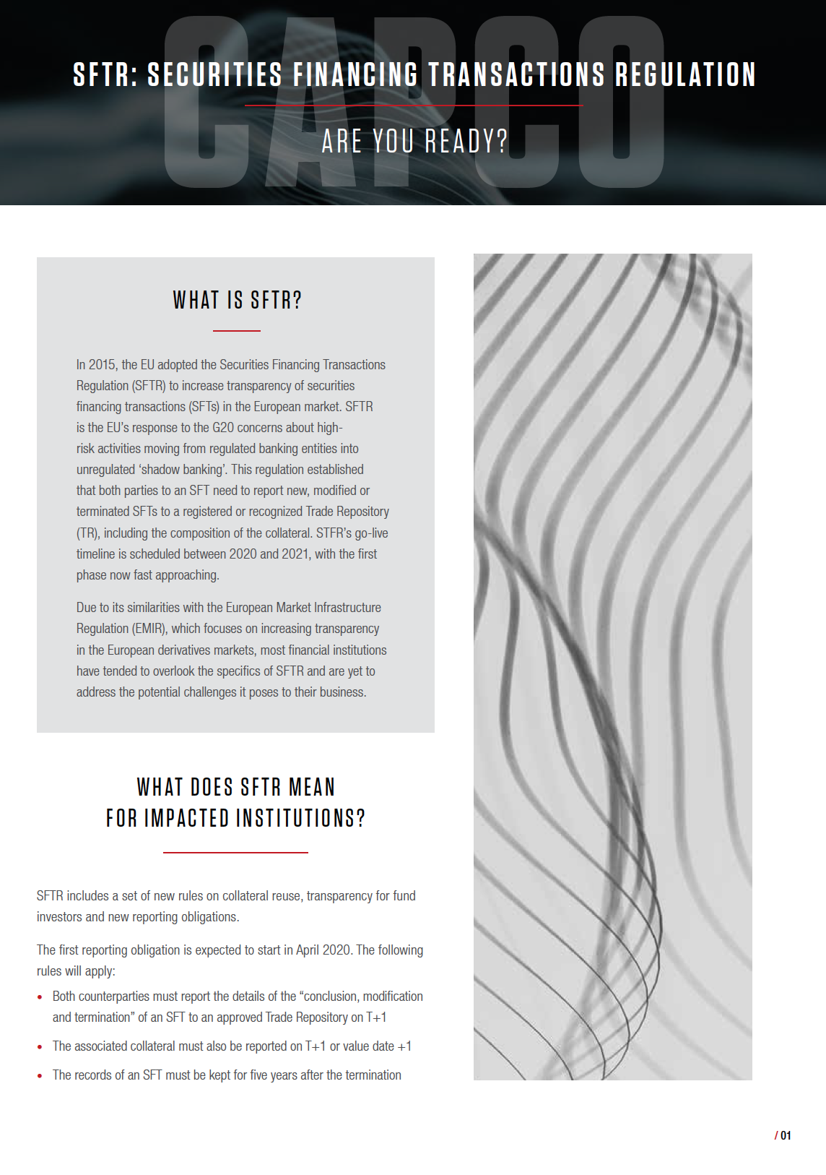


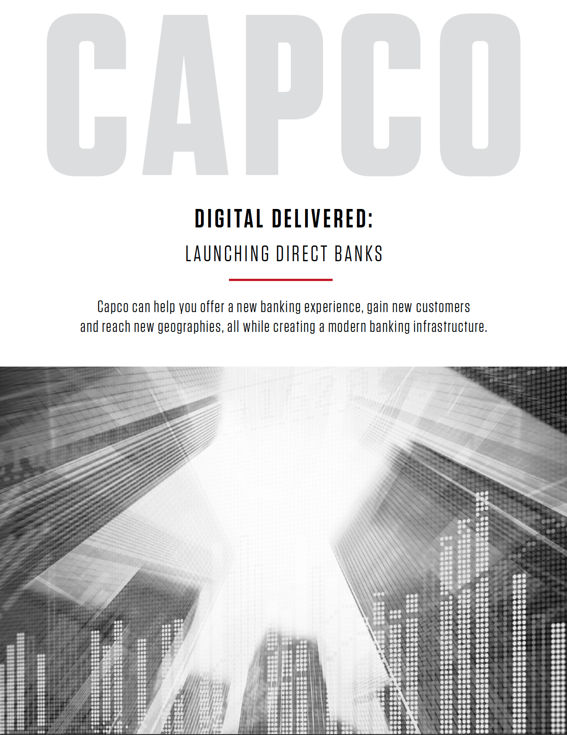
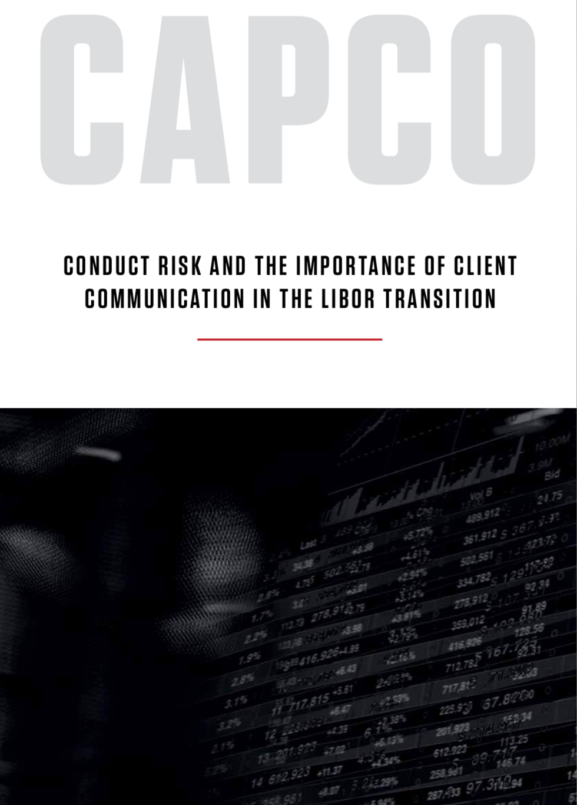


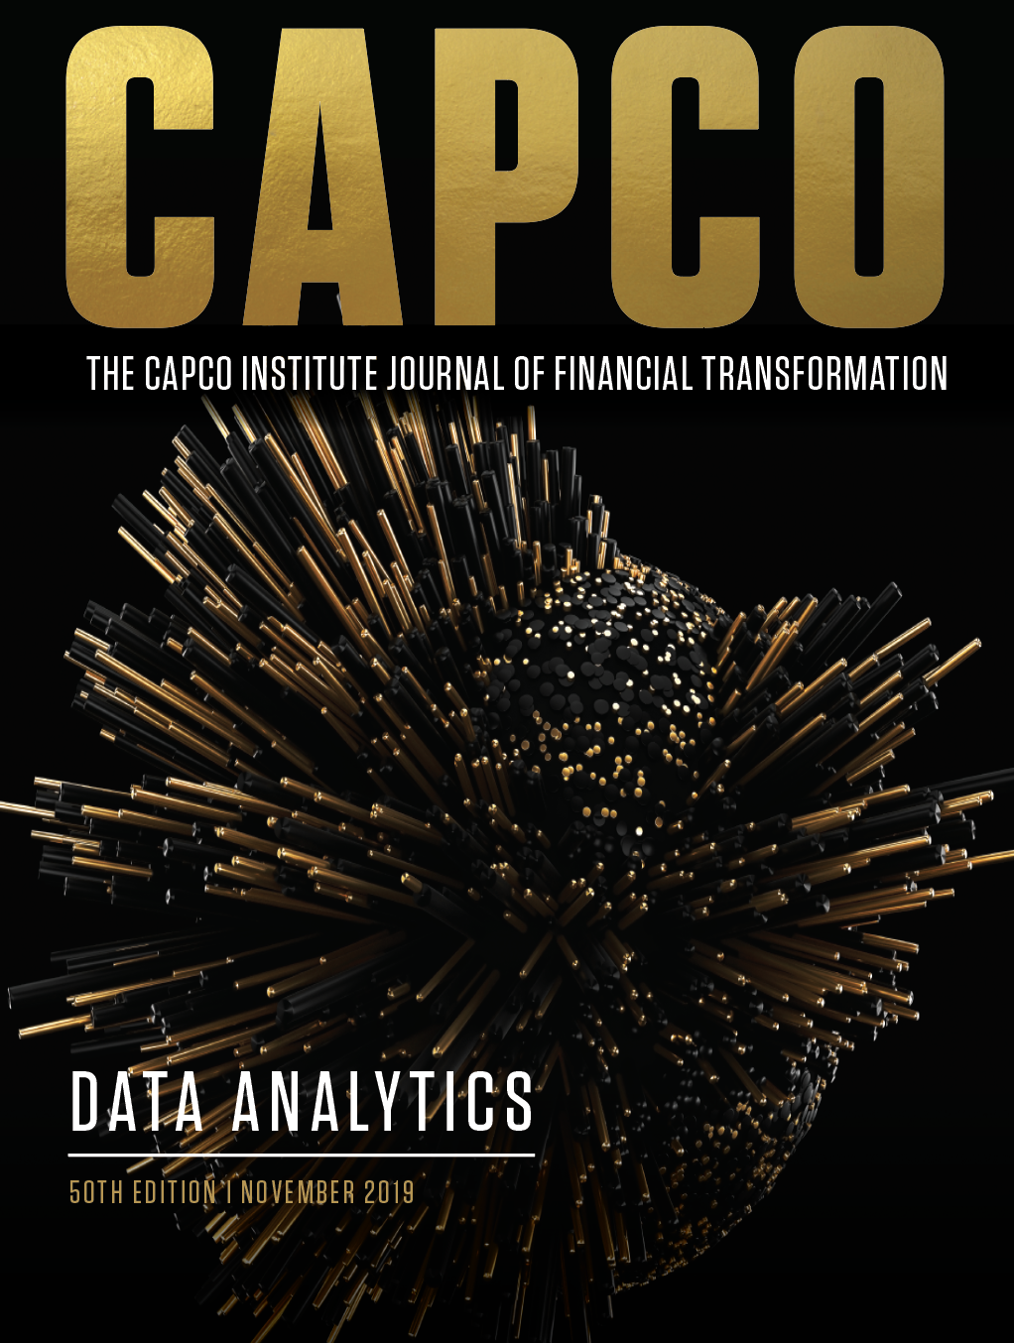
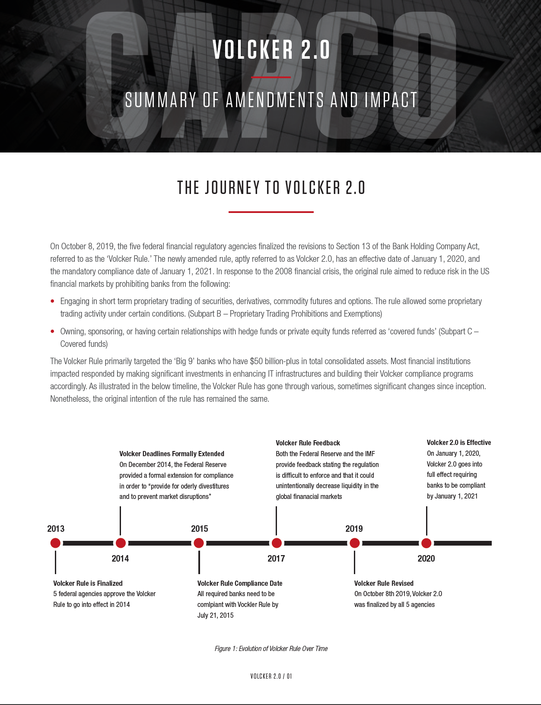

Solution Areas & thought leadership
Capco’s deep domain experience, thought leadership and dynamic culture provides clients with specialized consulting services across defined market offerings
BUSINESS CHANGE AND COST TRANSFORMATION
Uniquely, Capco combines deep industry expertise with an unmatched ability to execute transformative business and operational change, and apply cost-takeout strategies, through innovative methodologies and delivery excellence.
CAPCO DIGITAL
At Capco, we believe digital is driving a new way of doing business. Therefore, a holistic digital strategy should be integrated into all organizational activities. To be successful, organizations need a clear digital vision, a redefined operating model and an agile approach to delivering innovative solutions.
DATA AND TECHNOLOGY SOLUTIONS
Capco helps firms enable data-driven decision-making through the areas of machine learning, predictive models, text analytics and classification, image recognition, language translation, and process automation. With deep knowledge of the latest modeling and big data processes and technology trends, Capco delivers best-in-class solutions to complex data and analytics endeavors.
FINANCE, RISK AND COMPLIANCE
For banks, new regulations increase complexity and cost. Through guiding and implementing FRC strategies operationally and harnessing new and emerging technologies for RegTech, Capco has built a reputation of empowering clients to turn compliance into a competitive advantage.
TECHNOLOGY DELIVERY
In today’s ever-changing environment, your technology journey must be state-of-the-art and future-looking. Our focus and deep expertise in financial services helps us create, build and deploy front-to-back offerings, allowing us to provide end-to-end support to financial institutions seeking to rapidly integrate innovation.

